Slide 1
Lecture 3: Constructors, Getter & Setters Qurratulain Malik qmalik@keyin.com

Slide 2
Class vs Object Class Object
A blueprint for objects of a particular type
Defines the structure (number, types) of the attributes
Defines available behaviors of its objects
Attributes
Behaviors
Notes:
For example, one of the behaviors of an object may be to compute something. All the objects of the class will use the same formula for the computation, but the result may depend on the specific values of object’s attributes at the time of the computation.

Slide 3
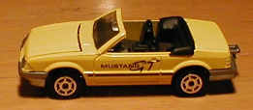
Class: Car Object: a car
Attributes:
String model
Color color
int numPassengers
double amountOfGas
Behaviors:
Add/remove a passenger
Get the tank filled
Report when out of gas
Attributes:
model = "Mustang"
color = Color.YELLOW
numPassengers = 0
amountOfGas = 16.5
Behaviors:
Notes:
The values of some attributes (such as model, color) may remain constant. The values of other attributes (such as number of passengers, amount of gas) may change while the program is running.
An object has a reference to the table of entry points for the methods of its class.

Slide 4
Class vs. Object
A piece of the program’s source code
Written by a programmer
Specifies the structure (the number and types) of its objects’ attributes — the same for all of its objects
Specifies the possible behaviors of its objects
An entity in a running program
Created when the program is running (by the main method or a constructor or another method)
Holds specific values of attributes; these values can change while the program is running
Behaves appropriately when called upon
Notes:
When an object is created, a chunk of memory is allocated to hold its attributes. When the object is no longer used by any other object, its memory is returned to the free memory pool (a process known as “garbage collection”).

Slide 5
What is a Constructor?
Constructor is a special method that gets invoked “automatically” at the time of object creation.
Constructor is used for Initializing the values to the data members of the class.
Constructor has the same name as the class name.
Constructors do not have a return type (not even void) and they do not return a value.
A class can have more than one constructor as long as they have different signature (i.e., different input arguments syntax).
Constructors have special syntax:
must always have the same name as their class
by convention, always start with capital letter (unlike other methods)

Slide 6
Constructors
Constructors are a special kind of methods that are invoked to perform initializing actions.
Circle() {
}
Circle(double newRadius) {
radius = newRadius;
}
A constructor is called whenever an object is created.
Enable you to create object instances with new XX()

Slide 7
//Emp.java
class Emp
{
private String name;
private String id;
private int salary;
Emp() // No argument constructor
{ name = “Ahmet";
id = "1234";
salary = 100;
}
// non-default constructor (Parametrized Constructor)
public Emp(String n, String i, int s)
{ name = n;
id = i;
salary = s;
}
void display()
{ System.out.println("\nEmploye Info ");
System.out.println("Name "+ name);
System.out.println("ID "+ id);
System.out.println("Salary "+ salary);
}
}

Slide 8
//ExEmp.java
class ExEmp
{
public static void main(String [] args)
{
Emp e1 = new Emp();
e1.display();
Emp e4 = new Emp("Ali","98745", 400);
e4.display();
}
}

Slide 9
Creating Objects Using Constructors
new ClassName();
Example:
new Circle();
new Circle(5.0);
Emp e1 = new Emp();
Emp e4 = new Emp("Ali","98745", 400);

Slide 10
public class Student {
private String name;
private String studentID;
private String surname;
private Course[] takenCourses;
private int state;
public Student(String nameParam,String surnameParam) {
name=nameParam;
surname=surnameParam;
}
public static void main(String[] args) {
Student s1 = new Student(“Onur”,”Saran”);
}
}

Slide 11
Types of Constructor
Constructor are of different types i.e.
Default
Parameterized
Copy Constructors.

Slide 12
Default Constructor
A class may be declared without constructors. In this case, a no-arg constructor with an empty body is implicitly declared in the class. This constructor, called a default constructor, is provided automatically only if no constructors are explicitly declared in the class.
Default Constructor is also called as “empty constructor” which has no arguments.
There is always at least one constructor in every class
If the programmer does not supply any constructors, the default constructor will be present automatically
The default constructor takes no arguments
The default constructor takes no body
default constructor will initialize each instance variable to its default value
Notes: If you add a constructor declaration with arguments to a class that previously had no explicit constructors, you lose the default constructor.

Slide 13
Defining a Constructor
Like any other method
Invoking:
There is NO explicit invocation statement needed: When the object creation statement is executed, the constructor method will be executed automatically.
public class ClassName {
// Data Fields…
// Constructor
public ClassName()
{
// Method Body Statements initialising Data Fields
}
//Methods to manipulate data fields
}

Slide 14
Parameterized Constructor
This is another type of constructor which has some arguments and same name as class name but it uses some arguments
We have to create object of Class by passing some arguments at the time of creating object with the name of class.
When we pass some arguments to the Constructor then this will automatically pass the Arguments to the Constructor and the values will retrieve by the Respective Data Members of the Class.

Slide 15
Adding a Multiple-Parameters Constructor to our Circle Class
public class Circle {
public double x,y,r;
// Constructor
public Circle(double centreX, double centreY, double radius)
{
x = centreX;
y = centreY;
r = radius;
}
//Methods to return circumference and area
public double circumference()
{
return 2*3.14*r;
}
public double area()
{
return 3.14 * r * r; }
}
}

Slide 16
Defining a Constructor: Example
public class Counter {
int CounterIndex;
// Constructor
public Counter()
{
CounterIndex = 0;
}
//Methods to update or access counter
public void increase()
{
CounterIndex = CounterIndex + 1;
}
public void decrease()
{
CounterIndex = CounterIndex - 1;
}
int getCounterIndex()
{
return CounterIndex;
}
}

Slide 17
Trace counter value at each statement and What is the output ?
public class Counter {
int CounterIndex;
// Constructor
public Counter()
{
CounterIndex = 0;
}
//Methods
public void increase()
{
CounterIndex = CounterIndex + 1;
}
public void decrease()
{
CounterIndex = CounterIndex - 1;
}
int getCounterIndex()
{
return CounterIndex;
}
}
class DemoClass { public static void main(String args[]) { Counter counter1 = new Counter(); counter1.increase(); int a = counter1.getCounterIndex(); counter1.increase(); int b = counter1.getCounterIndex(); if ( a > b ) counter1.increase(); else counter1.decrease(); System.out.println(counter1.getCounterIndex()); } }

Slide 18
new keyword
New operator dynamically allocates memory for an object during run-tme
class-var= new classname()
class-var is a variable of the class type being created
The classname is the name of the class that is being instantiated.
Class name is followed by parentheses specifies the constructor for the class.
A constructor defines what occurs when an object of a class is created.
Most real-world classes explicitly define their own constructors within their class definition.
If no explicit constructor is specified, then Java will automaticall supply a default constructor

Slide 19
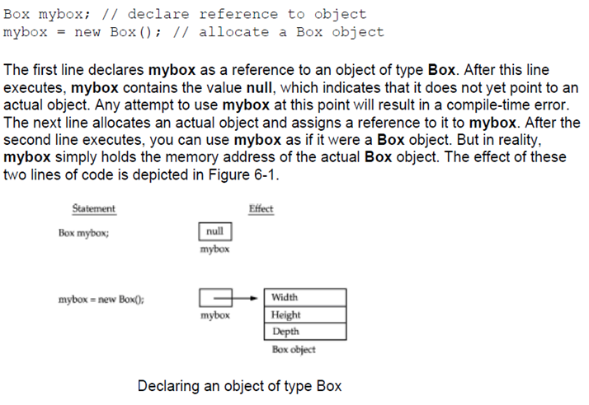
new keyword (Contd)

Slide 20
Multiple Constructors
Sometimes want to initialize in a number of different ways, depending on circumstance.
This can be supported by having multiple constructors having different input arguments. This is called constructor overloading.

Slide 21

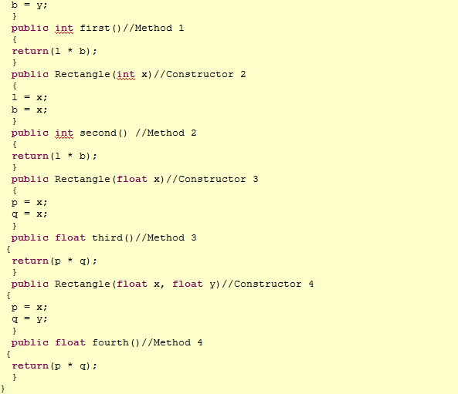
Constructor Overloading Example

Slide 22
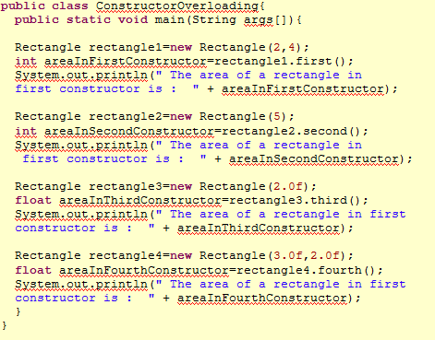
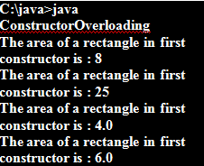
Constructor Overloading Example

Slide 23
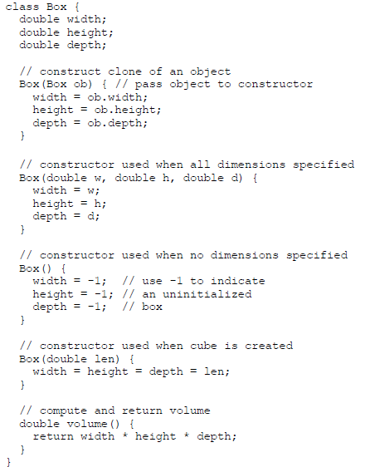
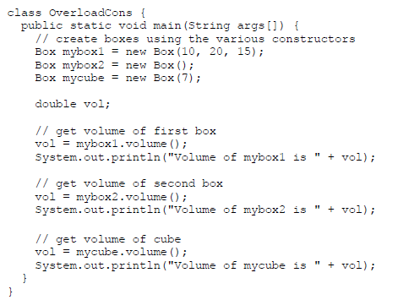

Overloading Constructors

Slide 24
public class bank_balance {
public String owner;
private int balance;
public bank_balance( String name, int dollars )
{
owner = name;
if (dollars >= 0)
balance = dollars;
else
dollars =0;
}
public int getBalance()
{
return balance;
}
public void setBalance(int dollars)
{
if (dollars >= 0)
balance = dollars;
else dollars = 0;
}
}

Slide 25
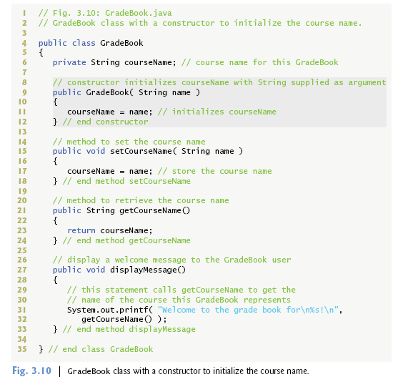
Accessors (getter) and Mutators (setter)

Slide 26
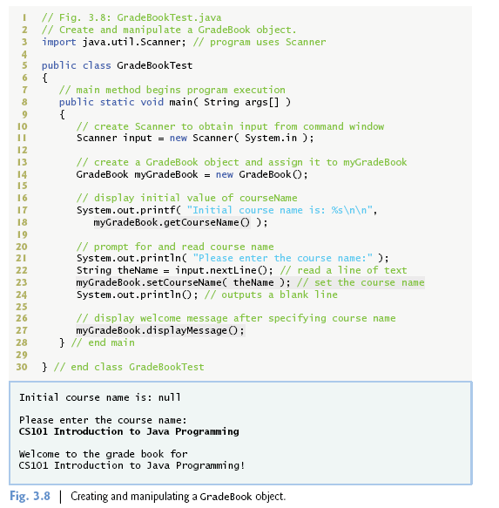
Accessors (getter) and Mutators (setter)

Slide 27
Thank you Enjoy Coding in Java

